Slide 1

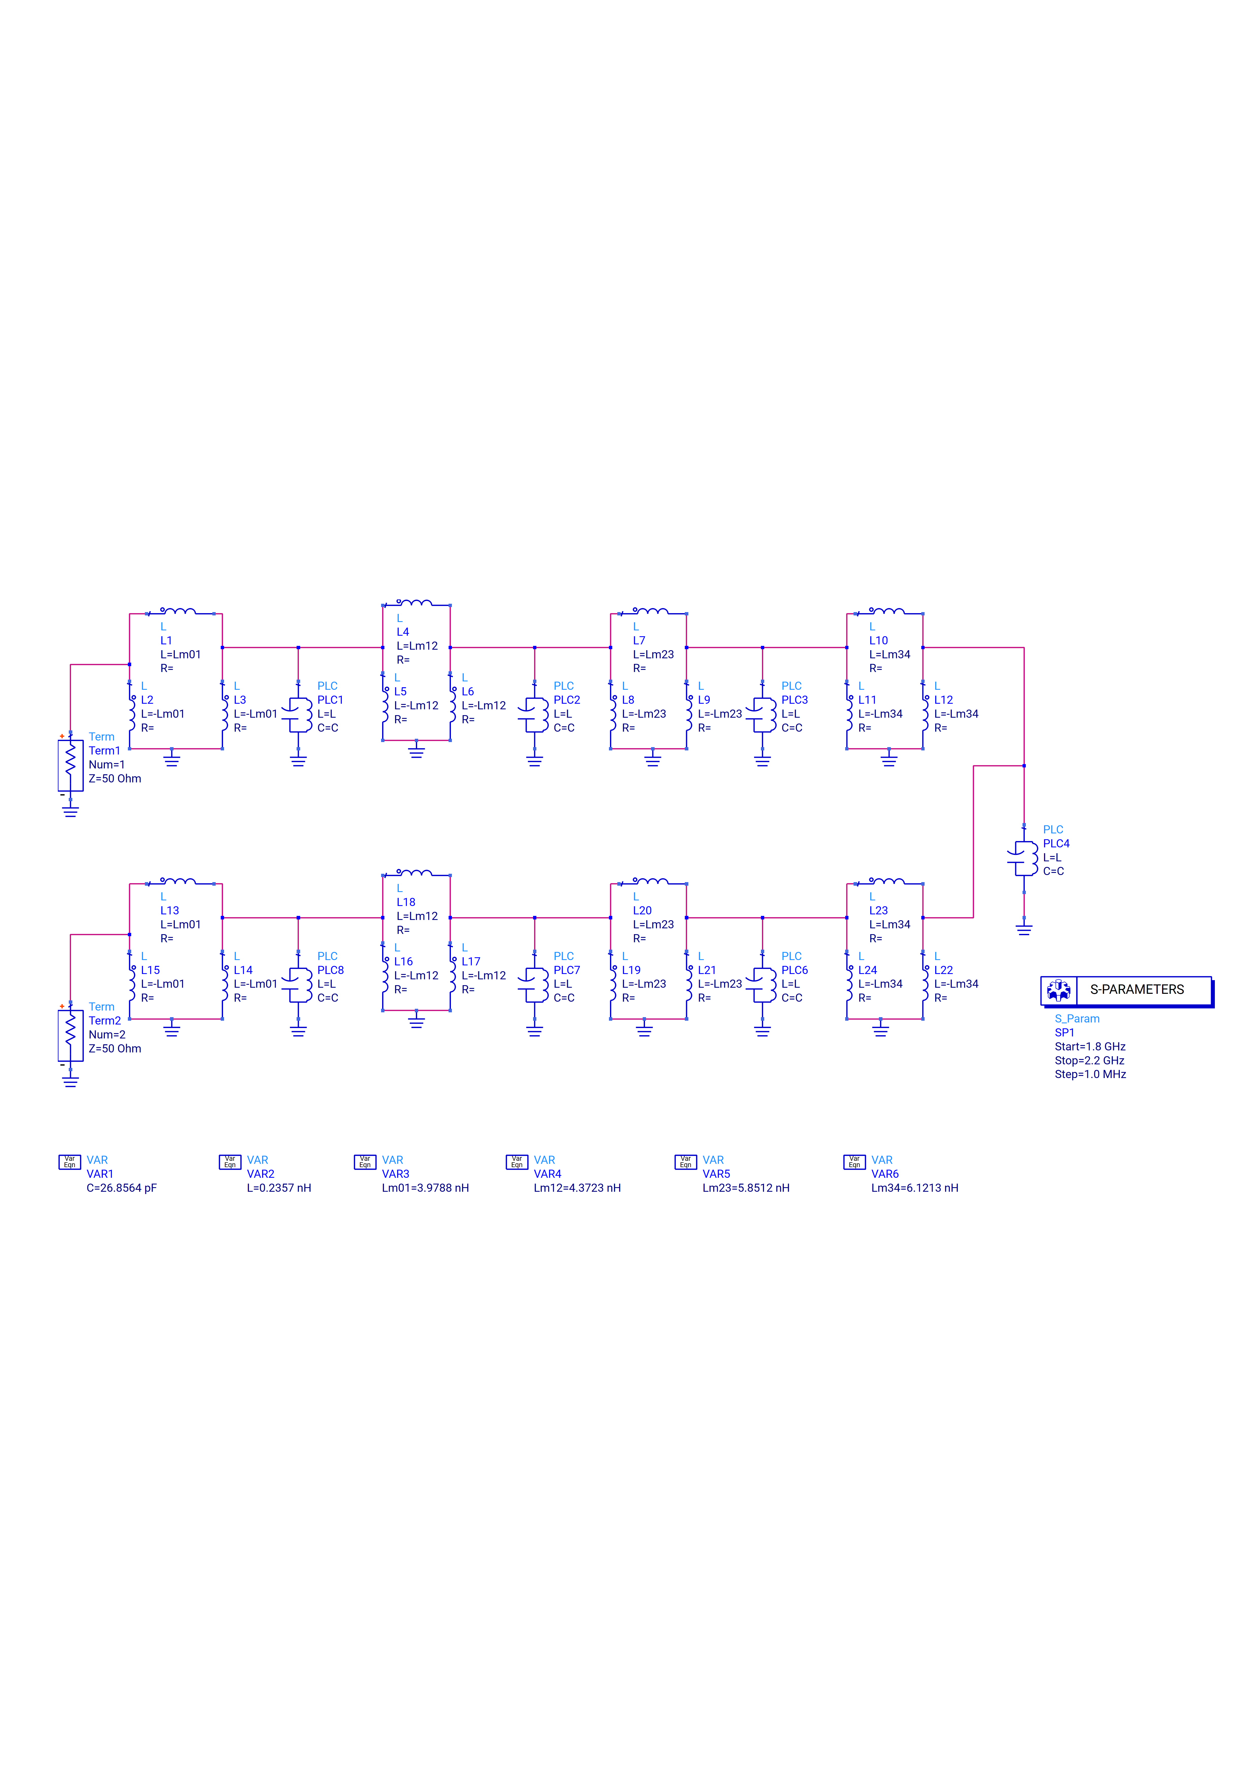
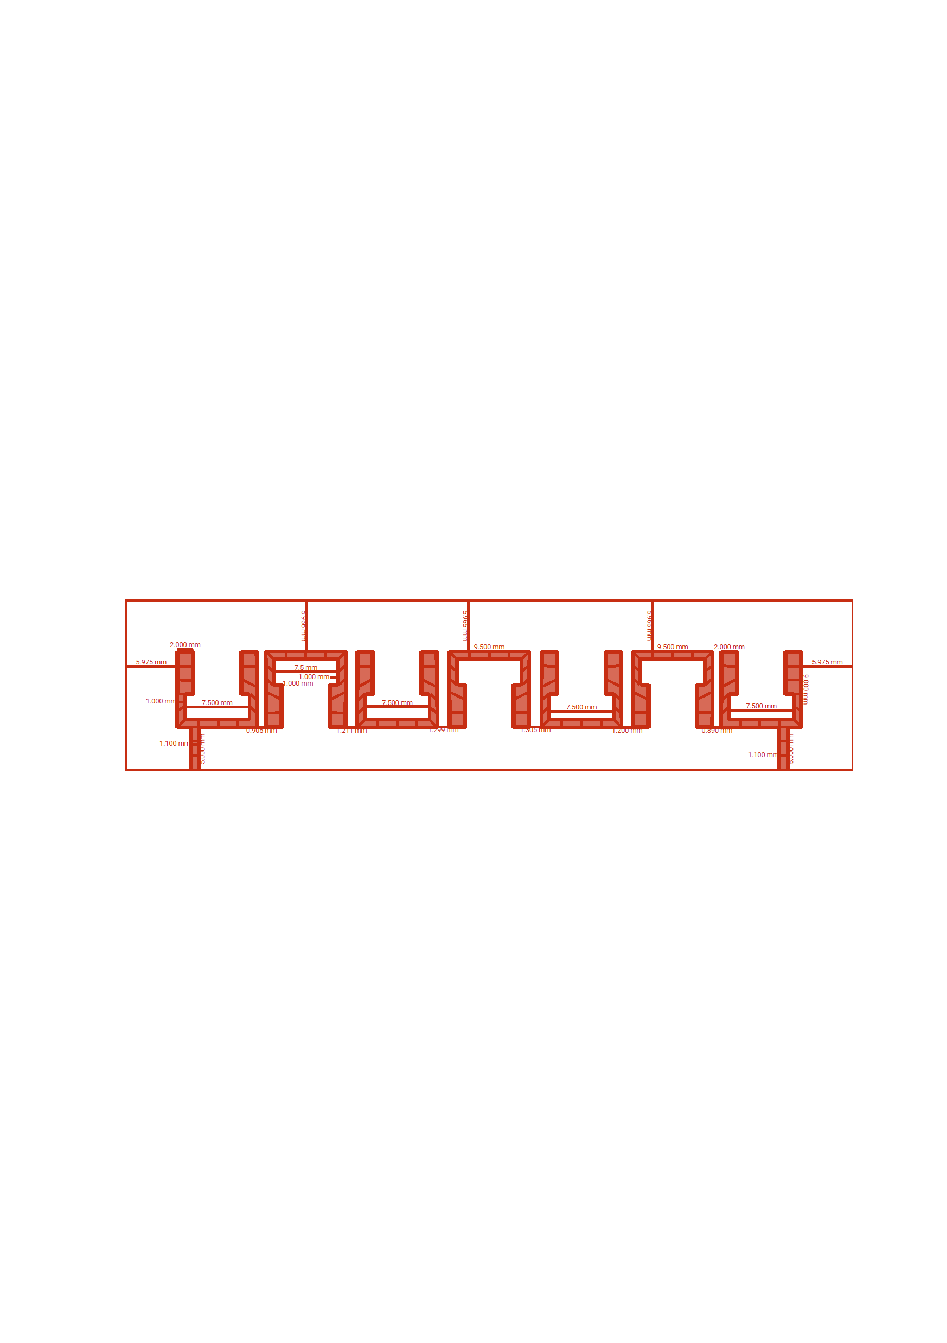
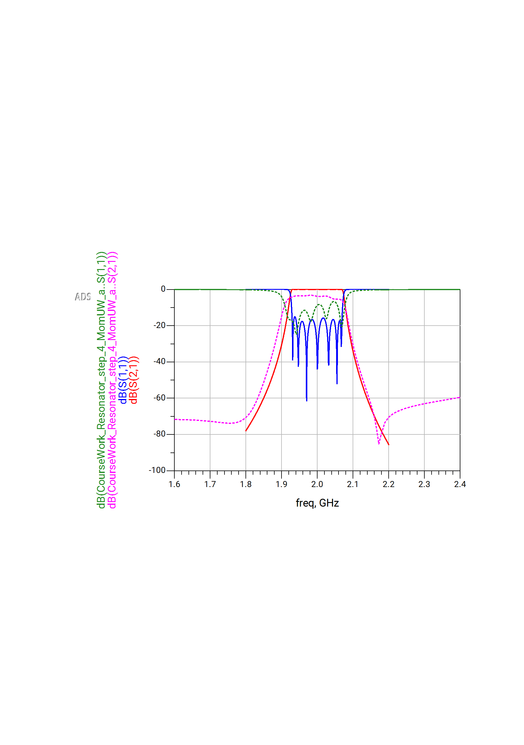
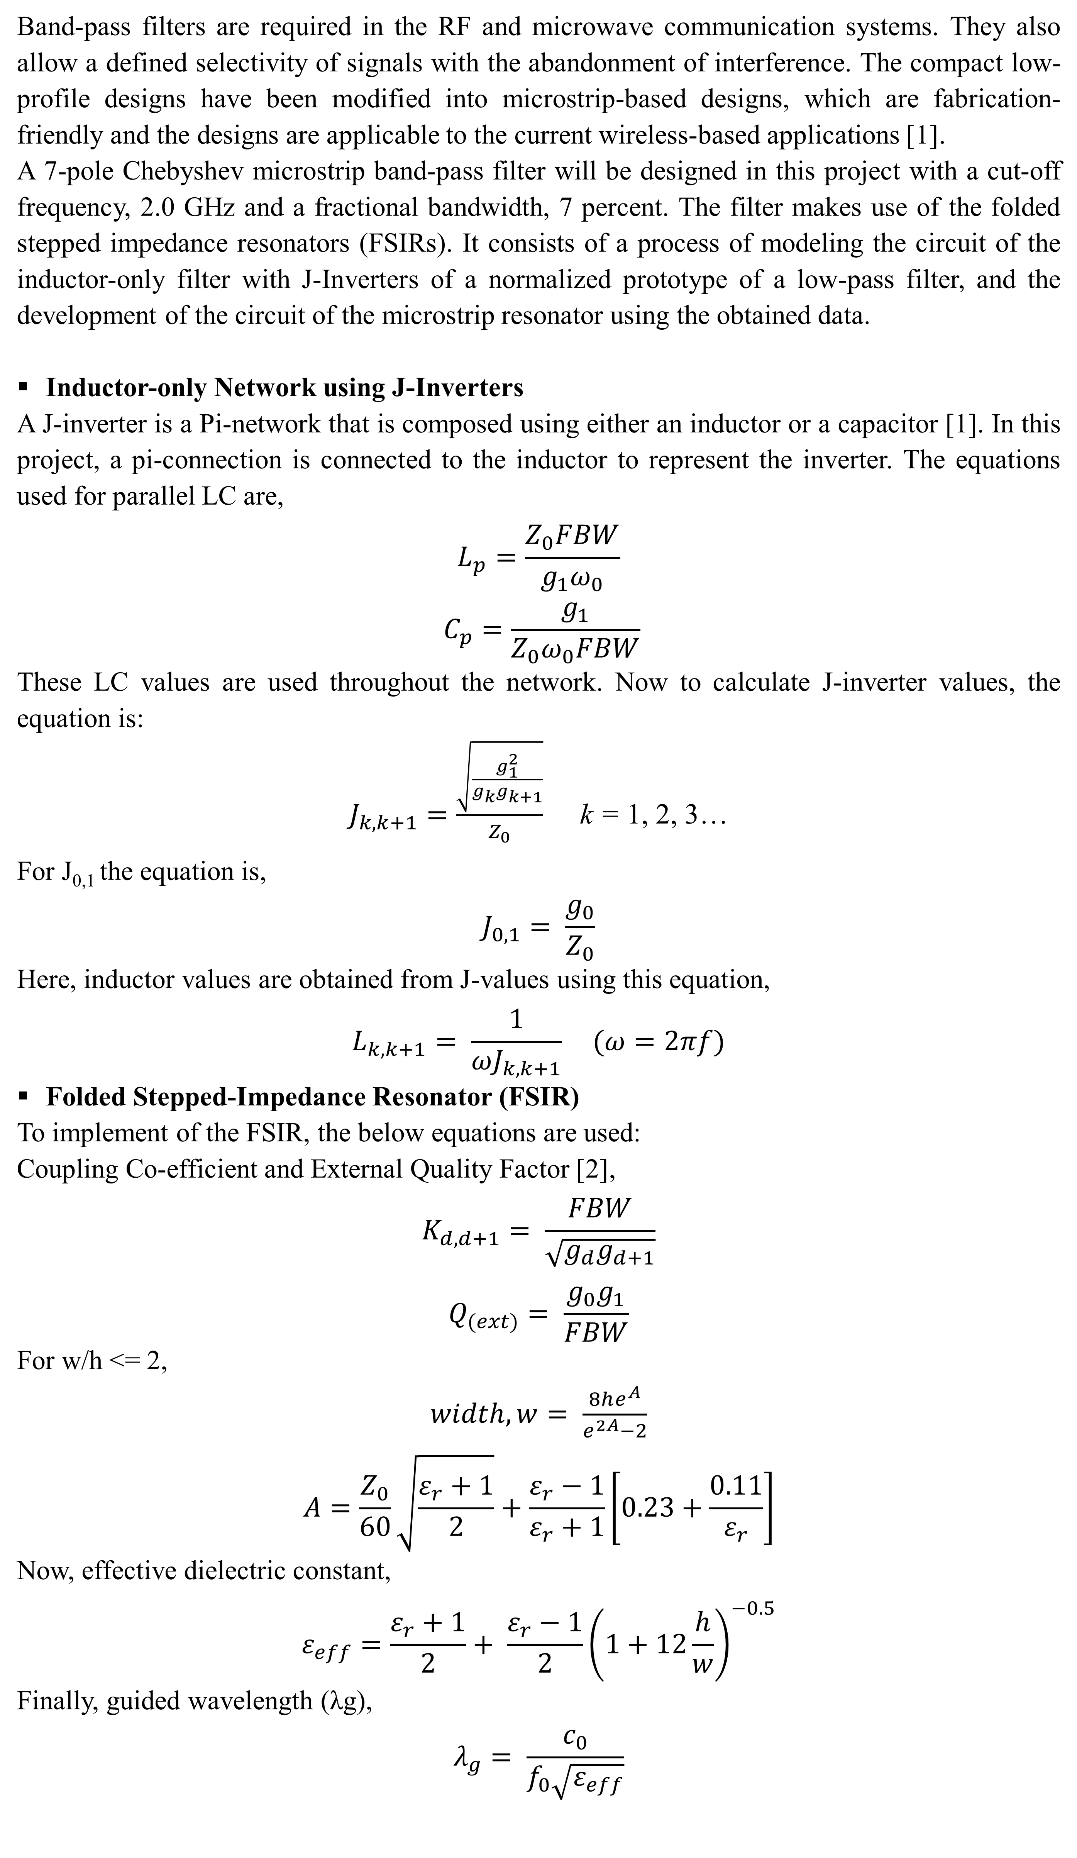
Design, Implementation and Analysis of a 7-Pole Chebyshev Microstrip Bandpass Filter at 2.0 GHz with a Specific Fractional Bandwidth
Ayan Dutta
Student ID: 001481129
Program: MSc, Applied Artificial Intelligence for Engineering
Abstract
This poster represents a seven-pole Chebyshev microstrip bandpass filter at 2.0 GHz, with folded stepped-impedance resonators, guided wavelength, coupling-coefficient synthesis, and external-Q tuning factor to steep selectivity and ripple control. Resonant performance and bandwidth insights of RF communications are verified by simulations.
Introduction
Band-pass filters are required in the RF and microwave communication systems. They also allow a defined selectivity of signals with the abandonment of interference. The compact low-profile designs have been modified into microstrip-based designs, which are fabrication-friendly and the designs are applicable to the current wireless-based applications [1].
A 7-pole Chebyshev microstrip band-pass filter will be designed in this project with a cut-off frequency, 2.0 GHz and a fractional bandwidth, 7 percent. The filter makes use of the folded stepped impedance resonators (FSIRs). It consists of a process of modeling the circuit of the inductor-only filter with J-Inverters of a normalized prototype of a low-pass filter, and the development of the circuit of the microstrip resonator using the obtained data.
Inductor-only Network using J-Inverters
A J-inverter is a Pi-network that is composed using either an inductor or a capacitor [1]. In this project, a pi-connection is connected to the inductor to represent the inverter. The equations used for parallel LC are,
$$L_{p}=\frac{Z_{0}FBW}{g_{1}ω_{0}}$$
$$C_{p}=\frac{g_{1}}{Z_{0}ω_{0}FBW}$$
These LC values are used throughout the network. Now to calculate J-inverter values, the equation is:
$J_{k, k+1}=\frac{\sqrt{\frac{g_{1}^{2}}{g_{k}g_{k+1}}}}{Z_{0}}$ k = 1, 2, 3…
For J_{0,1} the equation is,
$$J_{0,1}= \frac{g_{0}}{Z_{0}}$$
Here, inductor values are obtained from J-values using this equation,
$$L_{k, k+1}= \frac{1}{ωJ_{k,k+1}} (ω=2πf)$$
Folded Stepped-Impedance Resonator (FSIR)
To implement of the FSIR, the below equations are used:
Coupling Co-efficient and External Quality Factor [2],
$$K_{d, d+1}= \frac{FBW}{\sqrt{g_{d}g_{d+1}}}$$
$$Q_{(ext)}= \frac{g_{0}g_{1}}{FBW}$$
For w/h <= 2,
$width, w= \frac{8he^{A}}{e^{2A}−2}$
$$A=\frac{Z_{0}}{60}\sqrt{\frac{ε_{r}+1}{2}}+\frac{ε_{r}−1}{ε_{r}+1}\left[0.23+\frac{0.11}{ε_{r}}\right]$$
Now, effective dielectric constant,
$$ε_{eff}=\frac{ε_{r}+1}{2}+ \frac{ε_{r}−1}{2}{\left(1+12\frac{h}{w}\right)}^{−0.5}$$
Finally, guided wavelength (λg),
$$λ_{g}= \frac{c_{0}}{f_{0}\sqrt{ε_{eff}}}$$
Figure 1: Inductor-only Circuit using a J-Inverter
Here, the calculated guided wavelength (λg) = 56.1852 mm, and the base length of the resonator (λg/7) = 8.0264 mm; resonator arm width = 1 mm
And, the theoretical coupling coefficients and the external quality factor were calculated from the following equations:
K_{0,1} = K_{7,8} = 0.0644; K_{1,2} = K_{6,7} = 0.0539; K_{2,3} = K_{5,6} = 0.0405;
K_{3,4} = K_{4,5} = 0.0385, Q_{(ext)} = 16.8742;
These values were further compared and analyzed with the values that were obtained practically by the simulations. After adding up all the data, the desired FSIR layout was accomplished successfully, as shown in Figure 3.
Figure 2: Coupling Arrangements of FSIR
Figure 3: Microstrip Layout
Findings
A band-pass response is clearly illustrated by the simulated S-parameters, which are centered around the frequency of 2.0 GHz and have a stable attenuation in the stopbands.
The seven-pole Chebyshev behaviour and controlled ripple are indicated by several deep notches at the passband.
The FSIR layout, which is inverter-based, is much steeper on roll-off at both band edges, making it more selective.
Overall, the synthesis of the filter is justified by in-band low insertion loss and out-of-band high rejection.
Procedures
Figure 1 displays the inductor-only circuit of the seven-pole band-pass filter with a J-inverter. In this circuit, normalized values of prototype filter elements of low-pass filters are used. It is desired to have the center frequency as 2.0 GHz or 2000 MHz and the FBW as 7% with the characteristic impedances of input and output as 50 ohm (Ω).
PathWave Advanced Design System (ADS) was used to simulate the microstrip resonator layout. The layout was produced using the Rogers RT/Duroid 6010LM substrate with a dielectric constant of 10.7, a thickness of 1.27mm, and a loss tangent of 0.0023. To achieve a small size (dimensions in mm) of the resonator, a square open-loop resonator was employed in the design implementation, as shown in Figure 3.
Figure 4: Simulation Result Comparison
Conclusion
A seven-pole Chebyshev microstrip bandpass filter at 2.0 GHz is successfully designed and implemented with steep selectivity and controlled ripple by use of an FSIR design layout. Low insertion loss, high out-of-band rejection, and simulation verification of the synthesis methodology are all validated via simulation to support the use of modern RF communication applications.
[1] A. O. Nwajana and K. S. K. Yeo, "Practical Approach to Substrate Integrated Waveguide (SIW) Diplexer: Emerging Research and Opportunities: Emerging Research and Opportunities," 2020.
[2] A. Nwajana and E. Obi, "Application of Compact Folded-Arms Square Open-Loop Resonator to Bandpass Filter Design. Micromachines 2023, 14, 320," ed, 2023.

